Slide 1
OraLake: Building a Data Lake Using OracleDB

Slide 2
Project Team
A Project for DBMS Practice (CS 306)
Developed By: Siddharth Karmokar (123CS0061)
Kumar Bhaskar (123CS0056)
Supervised By:
Dr. Srinivas Naik
Mrs. Kotipalli Padmasri
Department of Computer Science, Indian Institute of Information Technology, Design and Manufacturing, Kurnool.

Slide 3
What We'll Cover Today
The Problem: Why managing different data types is hard.
Existing Solutions: What's already out there and where they fall short.
Our Solution: Introducing OraLake, a new approach.
How It Works: A look at the architecture and core functions.
The Results: Performance and key findings.
The Future: Where OraLake can go from here.

Slide 4
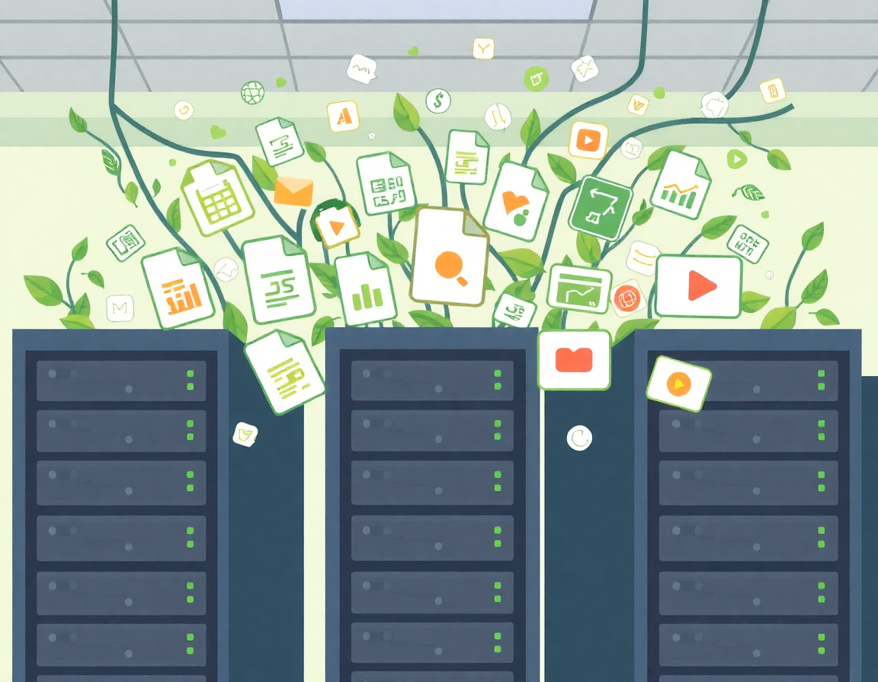
The Core Problem: A Digital Flood
Today, organizations deal with a massive amount of data that comes in all shapes and sizes. It's not just neat, organized tables anymore.

Slide 5
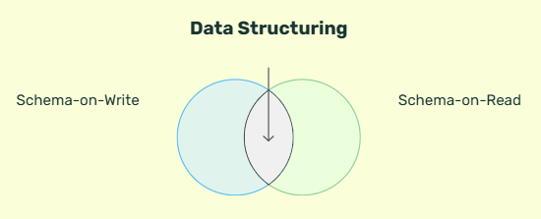
Fundamental Shift: Schema-on-Read vs. Schema-on-Write
The most significant architectural difference between traditional databases and data lakes lies in when the data structure, or schema, is applied. This distinction defines their flexibility, speed of ingestion, and use cases.

Slide 6
Schema-on-Write: The Traditional Approach
Definition
Example: User Registration
In a Schema-on-Write model, a schema is defined *before* any data is written to the database. The data must conform to this predefined structure upon ingestion. This is the standard for relational SQL databases (e.g., PostgreSQL, MySQL).
Structure is enforced upfront.
Ensures data quality and consistency.
Fast read performance as structure is known.
Slows down ingestion; data must be cleaned and transformed first.
A `users` table is created with specific columns: `user_id` (INTEGER), `email` (VARCHAR), `creation_date` (TIMESTAMP). When a new user signs up, their data must fit this structure exactly.
An attempt to insert data with a missing `email` or an incorrectly formatted date will be rejected by the database.

Slide 7
Schema-on-Read: The Data Lake Approach
Definition
Example: Web Server Logs
In a Schema-on-Read model, data is ingested in its raw, native format without a predefined schema. The structure is applied only when the data is read or queried for analysis. This provides immense flexibility and rapid ingestion.
No upfront schema definition required.
Accommodates all data types (structured, semi-structured, unstructured).
Extremely fast data ingestion.
Processing responsibility is shifted to the consumer or analytics tool.
A web server generates millions of log entries daily in a raw text format.
A data lake ingests these files directly. Later, a data analyst can apply a schema during a query to parse these logs, extracting IP addresses, request times, and user agents to analyze website traffic patterns. The raw data remains untouched.

Slide 8
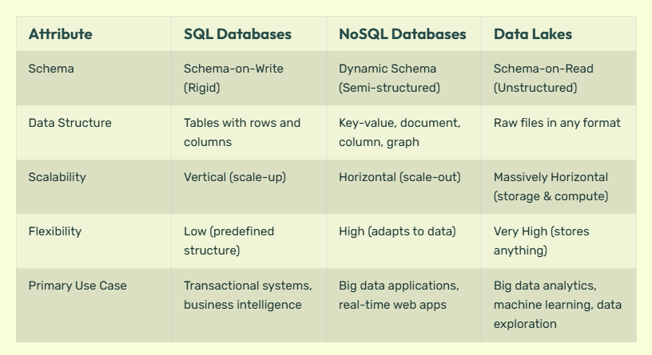
SQL vs. NoSQL vs. Data Lake: A Comparative Analysis
Understanding the key differences between these data storage approaches is critical for selecting the appropriate technology for a given task. Each paradigm is optimized for different requirements regarding structure, scalability, and flexibility.

Slide 9
SQL V/S NO SQL WITH AN EXAMPLE
1️⃣ SQL – The Structured Studio (Like “Baahubali” Production)
Think of Rajamouli’s “Baahubali” movie.
Every scene, costume, dialogue, and set was planned months in advance.
There’s a strict structure — one main hero (table), defined roles (columns), and fixed script (schema).
If Rajamouli wanted to add a new scene with a different character, it would require changing the whole plan (altering schema).
🎯 SQL Databases work the same — all data must fit a predefined structure.
2️⃣ NoSQL – The Flexible OTT Platform (Like “C/O Kancharapalem”)
“C/O Kancharapalem” has multiple small stories — different characters, tones, and endings.
Each story is independent, yet part of the same film (like documents in a collection).
There’s no single strict structure — some stories have romance, others philosophy, some comedy.
Director Venkatesh Maha could add another story later without disturbing others — just like adding a new document in NoSQL.
🎯 NoSQL lets you store and retrieve different data types freely — very flexible and scalable.

Slide 10
The Challenge with Traditional Databases
Struggle With (Unstructured Data)
Good At (Structured Data)
User Tables
Financial Records
Product Catalogs
BLOB data
CSV datasets
Images and Videos
Documents

Slide 11
What Are Traditional Databases Good At?
They excel at managing structured data. Think of a perfectly organized spreadsheet where every column has a specific purpose and every row is a neat entry.

Slide 12
Where Do They Struggle?
Rigid Structure (Schema)
Limited Metadata
You must define the data structure upfront. This makes it hard to store new types of data like images or complex JSON files without major changes.
It's difficult to add descriptive 'tags' or track different versions of a file directly within the database.
Complex Access
Getting to the unstructured content often requires special tools or complicated procedures, not simple queries.

Slide 13
The Goal: A Better Way to Manage All Data
We wanted to create a system that could handle all these different data types—structured and unstructured—within a single, reliable environment like OracleDB.
Flexibly store any data type.
Easily search and find data using tags.
Track changes and keep old versions.
Keep it simple and integrated within Oracle.

Slide 14
"Data Lake" is the Solution
A data lake is a central repository that allows you to store all your structured and unstructured data at any scale. Unlike a traditional database, you can store your data as-is, without having to first structure it.

Slide 15
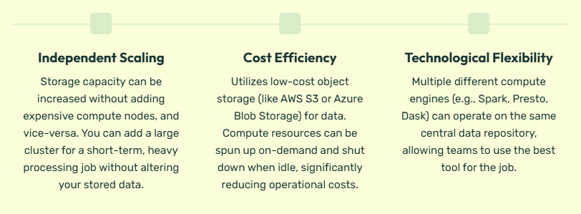
Key Principle: Coupling Storage and Metadata Management
OraLake tightly couples data and metadata within OracleDB. Both the stored objects and their metadata—versions, tags, and schema—exist together, ensuring consistency, easier management, and no external dependency on separate storage or catalog systems.

Slide 16
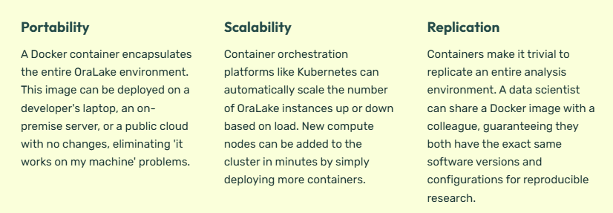
Deployment and Scalability: The Role of Docker
OraLake leverages Docker containers to enhance scalability, portability, and reproducibility. Containerization packages the application and its dependencies into an isolated, lightweight unit that can run consistently across any environment.

Slide 17
Implications of Decoupling: The ACID Trade-off
The decoupling of storage and compute, while powerful, can lead to challenges in maintaining ACID (Atomicity, Consistency, Isolation, Durability) properties, which are hallmarks of traditional relational database transactions.
Why ACID Properties May Be Violated
Atomicity: In a data lake, updating thousands of files in an object store is not an atomic operation. A failure halfway through can leave the data in an inconsistent, partially-updated state.
Isolation: Since multiple compute engines can access the same data simultaneously, a read operation might see data from a write operation that is still in progress, leading to a 'dirty read'. There is no inherent locking mechanism across the entire lake.
Consistency: Without strict transactional controls, complex updates can violate business rules, leading to an inconsistent state across different datasets within the lake.
Modern data lake frameworks like Delta Lake, Iceberg, and Hudi have emerged to address these issues by implementing transactional layers on top of object storage, bringing ACID-like guarantees to the data lake.

Slide 18
How Do Current Solutions Work? A Quick Look
Before building our own, we studied existing data management technologies to understand their strengths and weaknesses.

Slide 19
Existing Solution 1: Lakehouse Formats
Examples: Delta Lake, Apache Iceberg
What they do:
The Catch:
They bring database-like features (reliability, versioning) to large files stored in places like Amazon S3. They are powerful for big data analytics.
They require a separate storage system and complex big data tools (like Spark). They don't live inside a traditional database like Oracle.

Slide 20
Existing Solution 2: Schema-on-Read Engines
Examples: Apache Drill, Trino
What they do:
The Catch:
These tools let you run SQL queries directly on files (like JSON or CSV) without loading them into a database first. This is called 'schema-on-read'.
They are external tools. The data and its metadata live outside the database, making unified security and management difficult.

Slide 21
Existing Solution 3: Native Oracle Tools
Features: BLOB/CLOB Storage, JSON functions
The Catch:
What they do:
OracleDB can store large files (BLOBs) and has functions to work with JSON data. These are the basic building blocks.
Oracle doesn't provide a ready-made system for versioning, tagging, or easy searching. You have to build it all from scratch.

Slide 22
What's the Common Problem? The Gaps We Found.
After reviewing these solutions, we identified several key gaps that prevent teams from easily managing diverse data within their existing Oracle database.

Slide 23
Gap 1: External Dependence
Most powerful solutions force you to use external storage (like S3) and processing engines (like Spark). This adds complexity and cost, especially for teams that want to stick with their Oracle environment.

Slide 24
Gap 2: Lack of Tight Integration
When tools operate outside the database, you lose the benefits of database-centric features like ACID transactions, robust security models, and unified backup and recovery.

Slide 25
Gap 3: Fragmented Features
Even within Oracle, the features are fragmented. You can store a file, but there's no built-in way to tag it, version it, and search for it in one easy workflow. You have to connect the dots yourself.

Slide 26
Gap 4: Governance & Security Complexity
Using separate systems for storage and metadata means managing security and access rules in multiple places. This increases the risk of misconfiguration and data breaches.

Slide 27
Our Key Insight: The Opportunity for OraLake
There is a clear need for a data lake abstraction that lives entirely **inside** a relational database like Oracle. A solution that is:
Fully integrated, using Oracle's own features.
Simple to manage, without external dependencies.
Secure, inheriting the database's existing security.
Complete, offering storage, metadata, versioning, and search in one package.

Slide 28

Introducing OraLake: A Data Lake Inside OracleDB
OraLake is a data lake abstraction framework we built on top of OracleDB.
It extends the traditional database to store, manage, and retrieve different kinds of data like JSON, CSV, images, and videos.

Slide 29
The Vision of OraLake
To provide a unified interface for unstructured data handling within a structured database, combining the flexibility of a data lake with the reliability of Oracle.

Slide 30
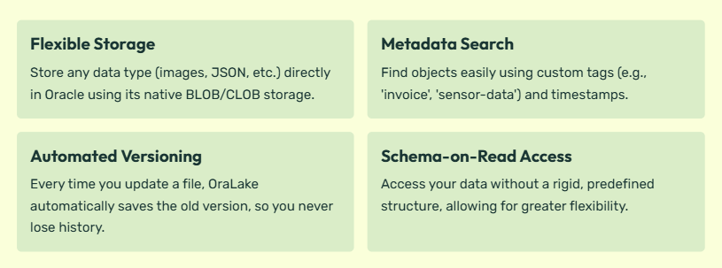
Core Features of OraLake

Slide 31
Data Evolution: Version Control in OraLake
Managing data changes over time is critical for reproducibility, auditing, and error recovery. OraLake moves beyond the traditional database transaction model by implementing a version control system for data, analogous to how Git manages source code.
This enables 'time-travel' queries, allowing users to query the state of the data as it existed at any specific point in the past.
After Every Change we don’t store the complete Data again but just the change which was made in that data and assign it some key so whenever user asks for a particular version we just revert those changes which is connected to that particular version.

Slide 32
Versioning vs. Traditional Commit/Rollback
Database Commit / Rollback
OraLake Versioning (Git Model)
This is a transient, session-based mechanism designed to ensure atomicity for a single transaction. Once a transaction is committed, the previous state is typically lost (overwritten). A rollback reverts changes within the current, uncommitted transaction only. It's about the integrity of a single, immediate change.
Transient and session-specific
Focuses on atomicity of one operation
Previous states are overwritten
Limited historical view
OraLake Versioning (Git Model)
This is a persistent, historical system that tracks the evolution of the entire dataset over time. Every change. It is not just about a single transaction, but the entire history of the dataset.
Persistent and historical
Focuses on data lineage and reproducibility
Previous changes are preserved.
Enables 'time-travel' and auditing

Slide 33
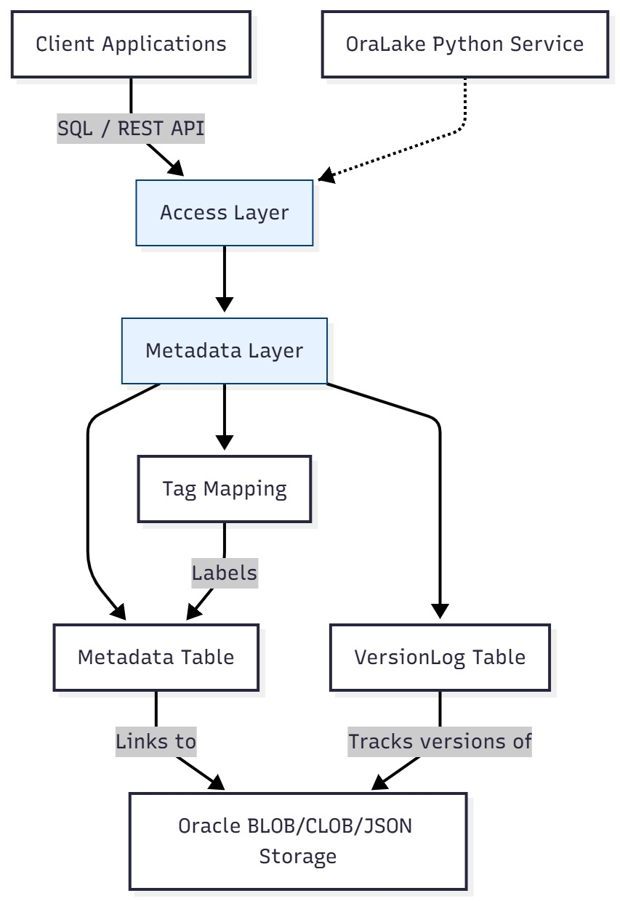

Slide 34
System Architecture: The Three Layers
1. Storage Layer
The foundation. This is where the actual data (files, images, JSON) is stored inside Oracle as BLOBs or CLOBs.
2. Metadata Layer
The brain. It keeps track of everything about the data: its name, type, version, tags, and when it was created.
3. Access Layer
The interface. This provides the functions to add, get, update, and search for data, either through SQL or an API.

Slide 35

Layer 1: The Storage Layer
This layer handles the physical ingestion of
data.
We use Oracle's native Large Object
(LOB)
Storage types: BLOB for binary data like
Images and CLOB for text-based data like
CSV and JSON.

Slide 36
Layer 2: The Metadata Layer
This is a set of tables that store data *about* your data. It answers questions
like:
What is the object's name?
What version is it?
What tags is it associated with?
When was it last updated?

Slide 37
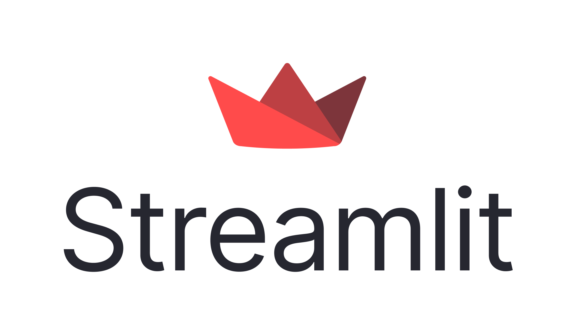

Layer 3: The Access Layer
This layer provides a set of pre-written
functions (a PL/SQL package) that make it
easy to interact with the data lake.
You don't need to write complex SQL; you
just call a function like `add_object` or
`query_by_tag`.

Slide 38
Access Layer Feature: Compression Logic
To manage storage costs and improve I/O performance, OraLake's access layer can apply compression to data. For multimedia files like video, this is particularly important. OraLake leverages established, powerful tools to perform this task efficiently.
Implementation via FFmpeg
OraLake utilizes the default compression methods provided by the `ffmpeg` package, a leading open-source multimedia framework. When storing or retrieving video data, the access layer can invoke `ffmpeg` to:
**Transcode videos** to more efficient codecs (e.g., H.265) to reduce file size while maintaining visual quality.
**Resize resolutions** to create smaller thumbnails or proxies for faster previewing.
**Extract audio tracks** or specific frames for targeted analysis.
This logic is applied transparently, meaning the user can request a file and the access layer determines whether to serve the raw version or a compressed, processed version based on the query context.

Slide 39
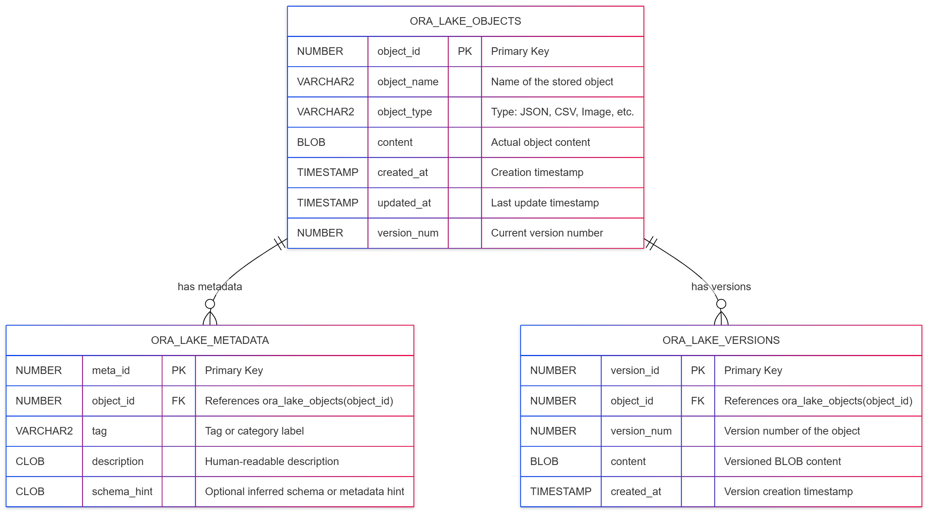
The Database Blueprint: ER Diagram
This diagram shows the logical relationships between the main entities in our system:
The Objects themselves, their Metadata, their Tags, and their Version History.

Slide 40
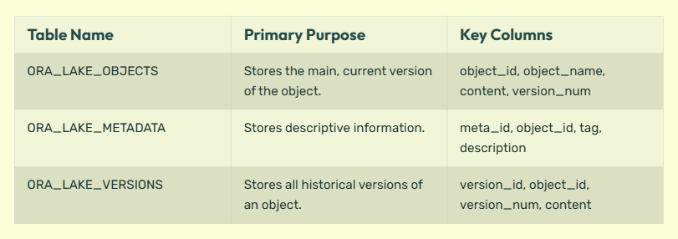
The Database Structure: Relational Schema
Here are the actual tables we created in Oracle to store the data and metadata.

Slide 41
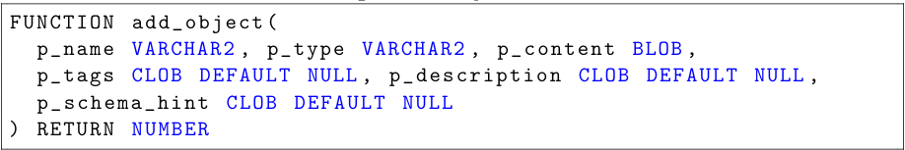
Core Operation: Add Object
When you add a new file, the `add_object` function does three things at once:
Inserts the data into the main `ora_lake_objects` table as Version 1.
Copies the same data into the `ora_lake_versions` table to start its history.
Creates an entry in the `ora_lake_metadata` table with any tags you provide.

Slide 42

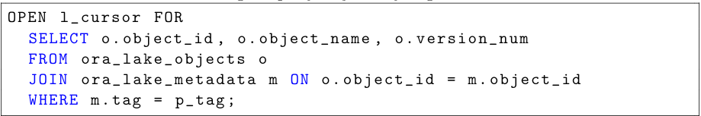
Core Operation: Retrieve & Search
You can fetch an object by its unique ID or, more powerfully, search for all objects with a specific tag.
Example: `query_objects_by_tag('IoT’)`
This would return a list of all datasets, images, or documents that you have previously tagged with 'IoT'.

Slide 43
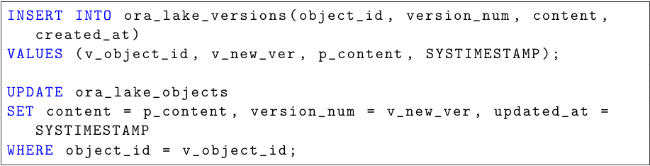
Core Operation: Update & Version
When you `update_object`, it doesn't just overwrite the old data. Instead, it:
Adds the new changes as a new, higher version number in the `ora_lake_versions` table.
Updates the main `ora_lake_objects` table to point to this new version.
This ensures the full history is preserved and no data is ever truly lost.

Slide 44
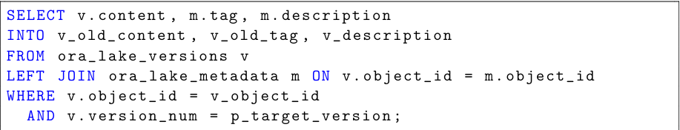
Core Operation: Rollback
Made a mistake? The `rollback_object` function lets you revert a file to any of its previous versions.
How it works:
It looks up the requested version number in the `ora_lake_versions` history table, retrieves that old content, and makes it the current version in the main `ora_lake_objects` table.

Slide 45
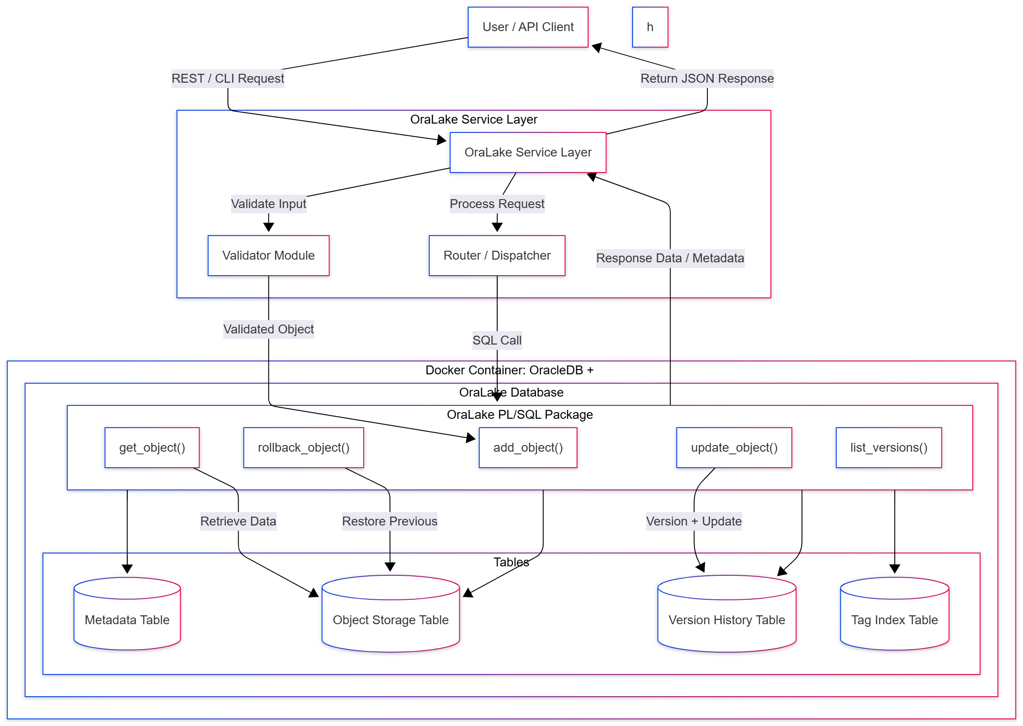
Data Workflow

Slide 46
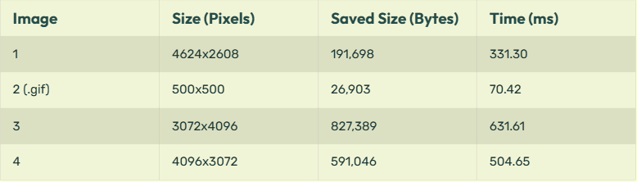
Results
Performance Metrics: Upload Speed
We uploaded several images of different sizes to measure the insertion time. The average time was approximately 376 milliseconds, showing efficient handling of data.

Slide 47
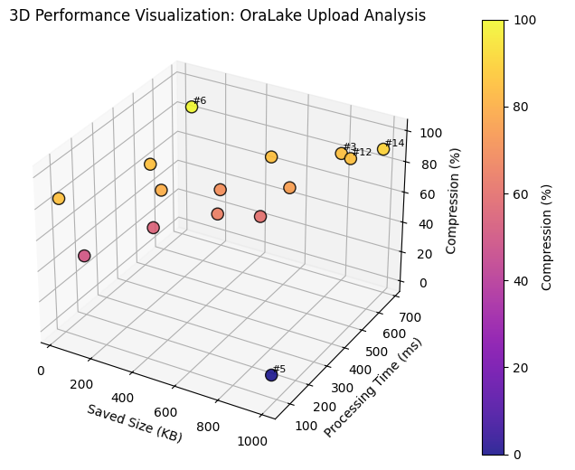
Performance Visualization
Plotting upload time against image size shows that latency scales moderately. The system remains efficient even as file sizes increase.

Slide 48
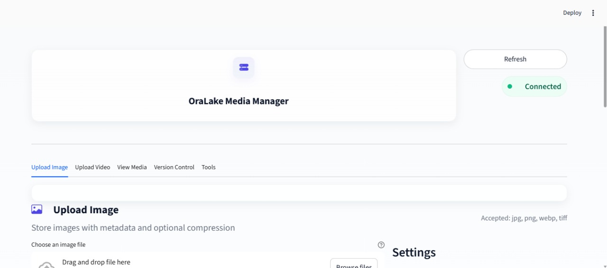
Home Page

Slide 49
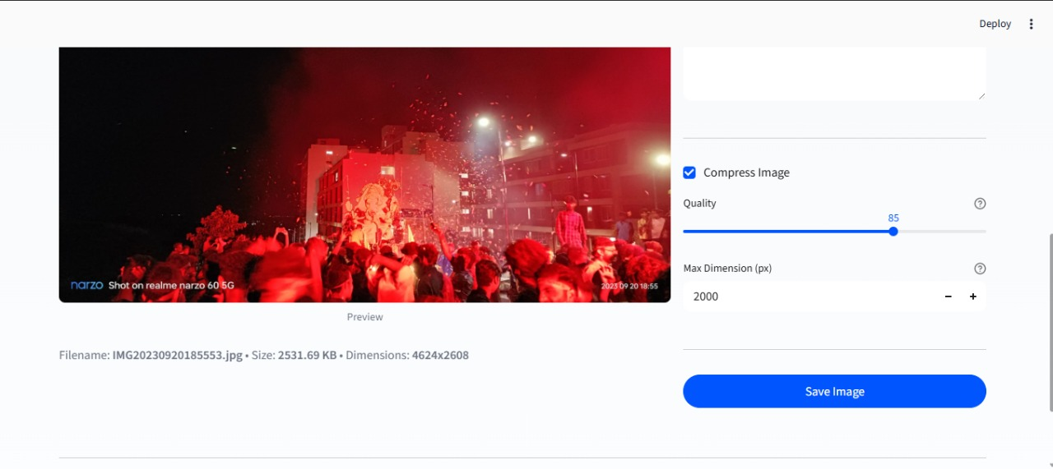
Add Object

Slide 50
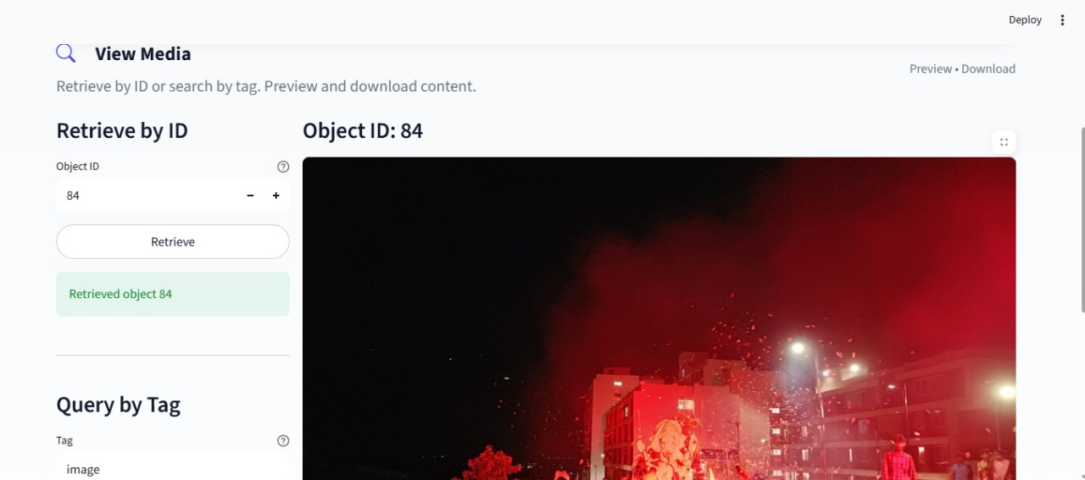
Retrieve Object

Slide 51
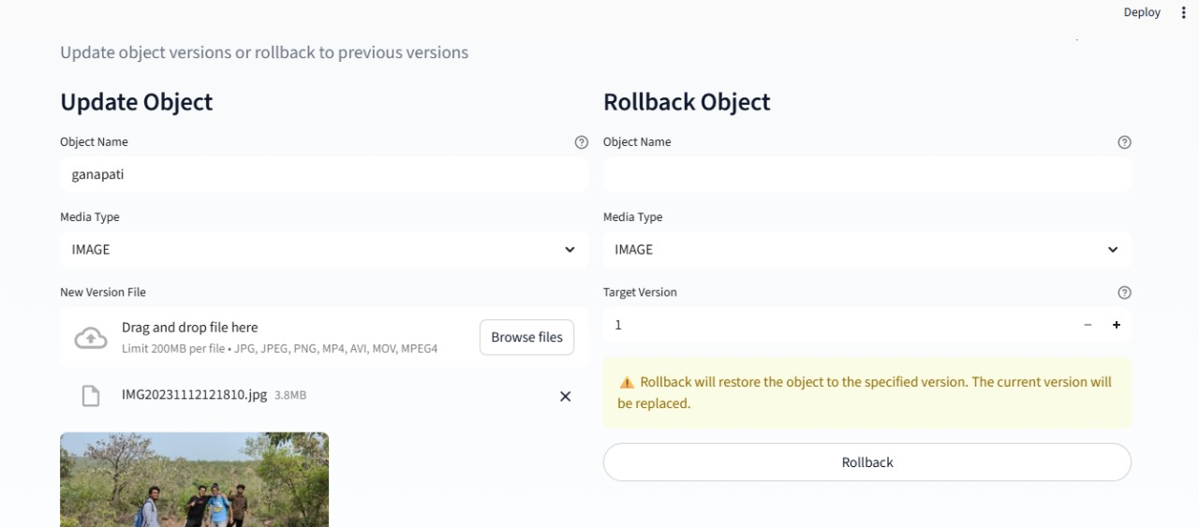
Update Object

Slide 52
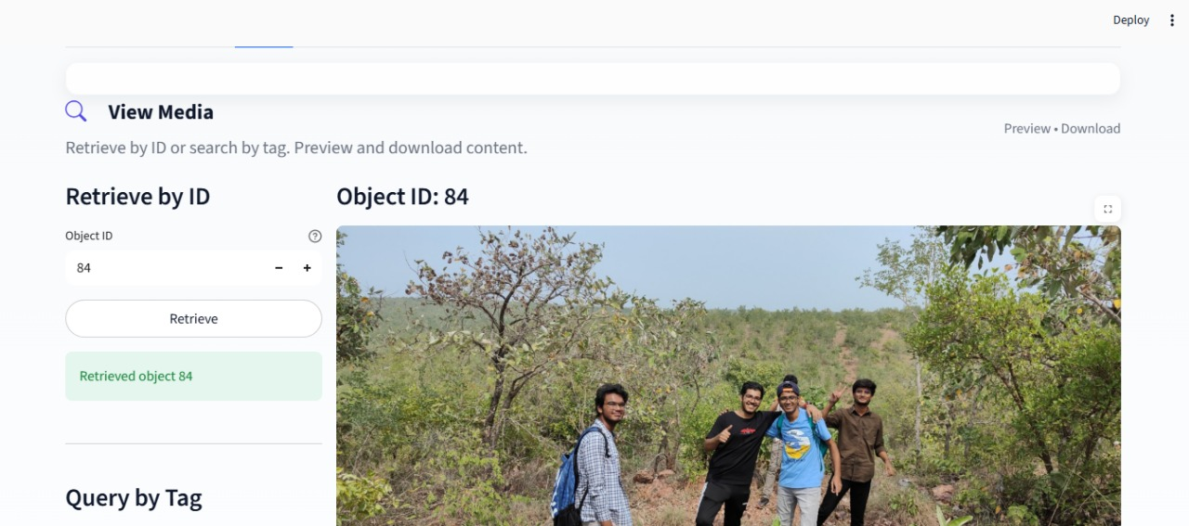
Update Object Results

Slide 53
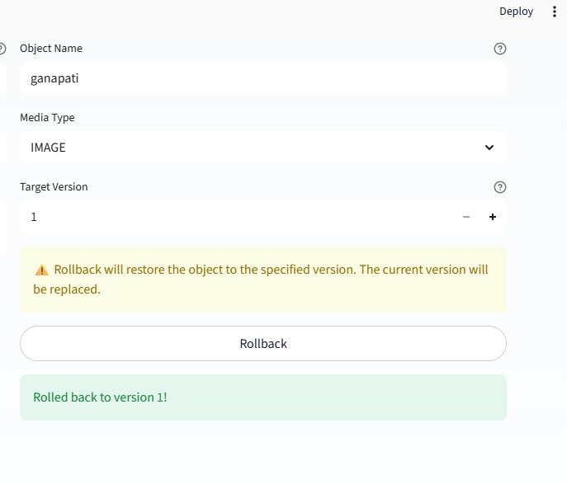
Rollback

Slide 54
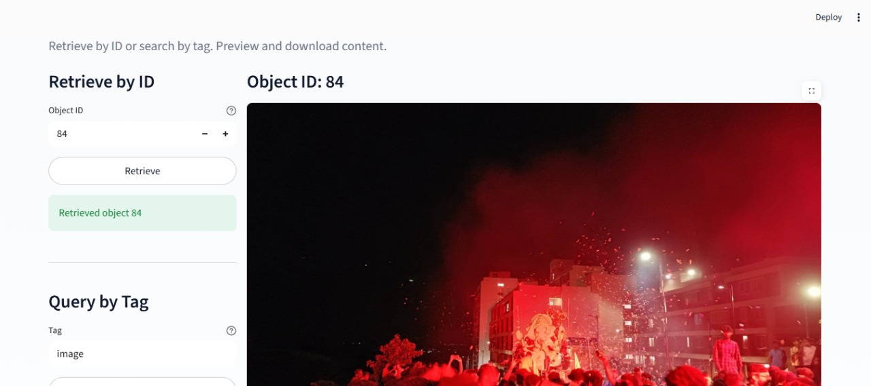
Rollback Results

Slide 55
Rollback Results

Slide 56
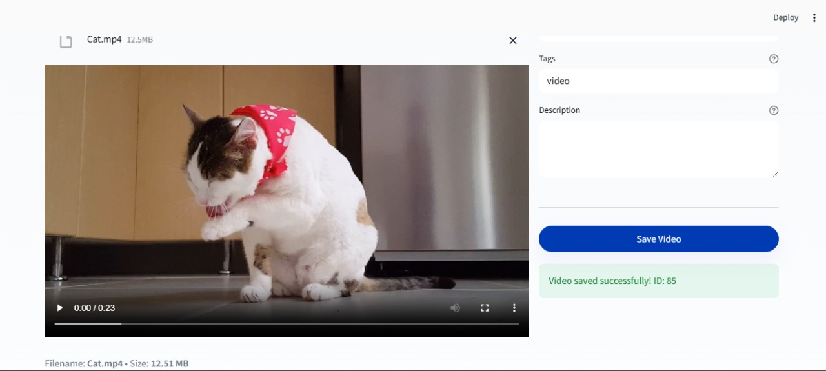
ADD OBJECT VIDEO

Slide 57
Conclusion: What We Achieved
OraLake successfully demonstrates that a traditional Oracle database can be extended into a flexible data lake framework.
We built a system that handles various data types (JSON, Images, Videos).
It provides essential data lake features: schema-on-read, versioning, and metadata tagging.
The design is integrated entirely within Oracle, avoiding external dependencies.
Performance is stable and suitable for small-to-medium enterprise use.

Slide 58
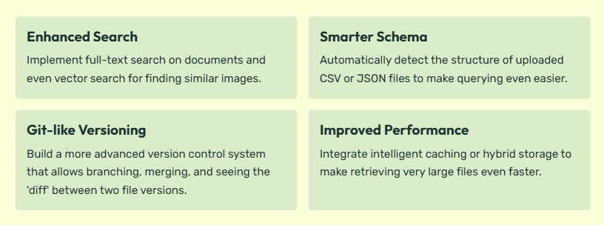
The Road Ahead: Future Work for OraLake

Slide 59
THANKS!
Do you have any questions?

